Slide 1
Sideline Coach
Player creator and scoreboard App
Brad Cook – 12th March 2020

Slide 2
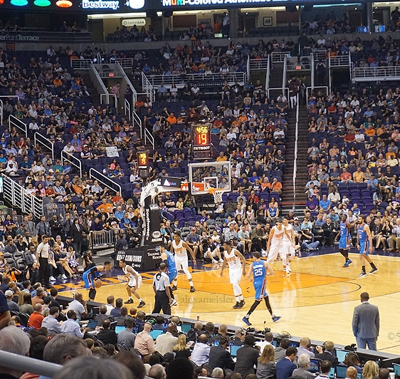
What is Sideline Coach
NOTE:
To change images on this slide, select a picture and delete it. Then click the Insert Picture icon
in the placeholder to insert your own image.
Sideline Coach is a dynamic player creator complete with scoreboard functionality.

Slide 3

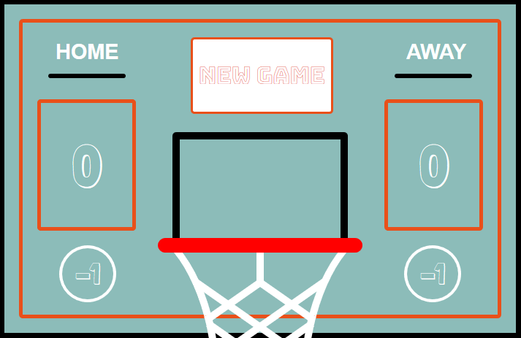
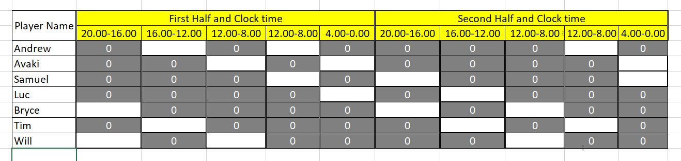
Design Process
It all started with a grand plan!

Slide 4



Notable Technologies Used
ReactJS
Node and WebExpress server
MongoDB

Slide 5
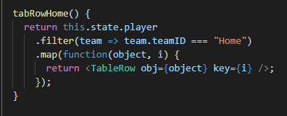
Celebrate your victories!
Array.prototype.filter()
The first part of the method (.filter) creates a new array with all elements that pass the condition provided.
The second part of the method (.map) loops through and displays the results.

